Slide 1
The Ethical Implications of using Artificial Intelligence in Auditing
Helen Brown-Liburd
Ivy Munoko
Miklos A. Vasarhelyi

Slide 2
Research Problem
Academia, professionals, policymakers, regulators, and developers are increasingly becoming aware of ethical concerns that stem from emerging technology (Wright and Schultz 2018; Aicardi, Fothergill, Rainey, Stahl and Harris 2018).
Ethics researchers have sought the best approach for identifying the ethical risks of emerging technology during their introductory phase (Allen, Smit and Wallach 2005; Wright 2011; Brey 2012; Stahl, Timmermans and Flick 2017).

Slide 3
Research Problem
There are projections that 30% of corporate audits will be performed by AI by 2025 (World Economic Forum 2015).
Regulatory bodies are initiating oversight programs to anticipate and respond to the risks posed by the use of emerging technologies (PCAOB 2018; IAASB 2018).
“AI technologies are rapidly outpacing the organizational governance and controls that guide their use” in firms (Cobey, Strier and Boillet 2018).
Calls for research into the impact of the use of AI in accounting and auditing (e.g., Issa, Sun, and Vasarhelyi 2016; Sutton, Holt, and Arnold 2016; Kokina and Davenport 2017)

Slide 4
Research Objectives
Project what the future implications will be of using AI in auditing
Draw on two established emerging technology ethical frameworks to forecast the ethical implications of AI in an audit context
Ethics of Emerging Information and Communication Technologies (ETICA)
Anticipatory Technology Ethics (ATE)

Slide 5
Research Scope
Although numerous issues associated with AI are identified in the course of the study, results analyzed are specific to issues impacting Auditing profession.
Bibliometric analysis of ethics/technology publications from 2000 and cover only articles in technology ethics journals

Slide 6
Literature Review
The accounting and auditing profession embraced AI in the early 1980s (Vasarhelyi 1989; O’Leary and Watkins 1995).
At that time, there was a much simpler versions of AI in commercial use (e.g., Expert Systems) than those of today.
The ethical implication of expert systems was not evident during the initial years of implementation (Elliott, Kielich, Rabinovitz, and Knight 1985).
However, in the 1990s, some researchers began to observe the ethical effects of expert systems, including their lack of some cognitive skills (e.g., intelligence, emotions, and values) and bias (Khalil 1993).

Slide 7
Literature Review
“Data is being used differently than in past audits” with resultant “legal and regulatory challenges” (IAASB 2018, pg 7).
A futuristic approach is required to identify the impact of emerging technology (Brey 2012).
One futuristic ethics framework is the ETICA, developed by a European consortium (Stahl et al. 2010).
A second futuristic framework is Anticipatory Technology Ethics (ATE) (Brey 2012), which builds on the ETICA framework.

Slide 8
Constructs in the Futuristic Frameworks
App
Consider technology independent of use
Technology
Artifact
Consider intended use
Application
Consider unintended consequences

Slide 9
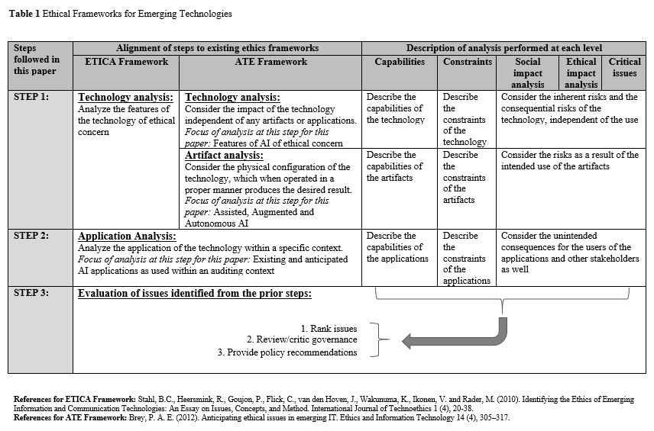
Ethical Frameworks - A futuristic approach

Slide 10
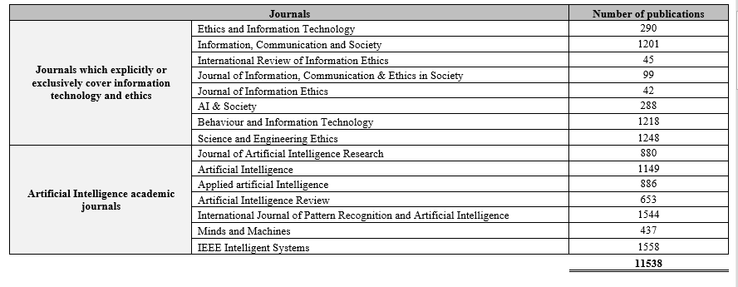
Data - Bibliometric Analysis

Slide 11
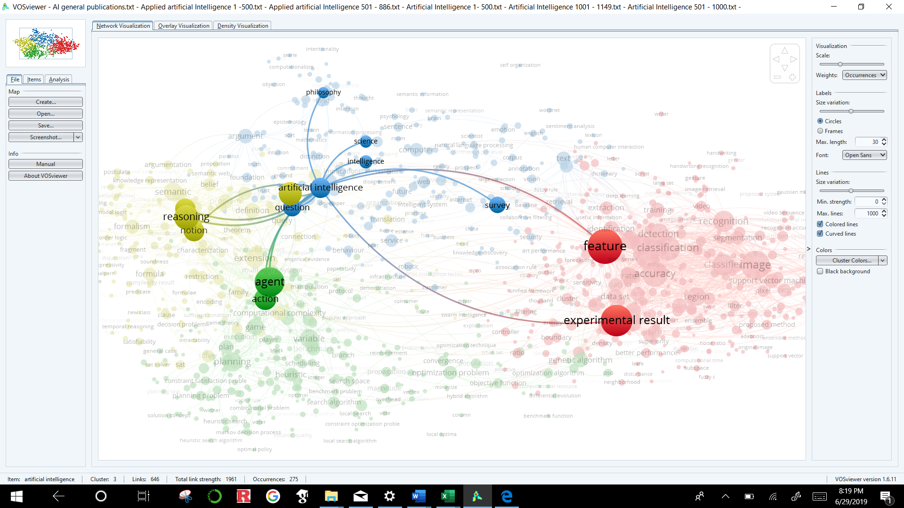
Bibliometric Analysis - Tool
VOSviewer is a software tool for creating maps based on data
items are the objects of interest
link is a connection or a relation between two items
each link has a strength, represented by a positive numerical value

Slide 12
Bibliometric Analysis - Tool
Ethical issues of AI are becoming more prominent within the recent years

Slide 13
Ethical Issues identified - technology
Data: 11,538 publications
Method: Bibliometric analysis
Ethical checklist
App
Technology
Artifact
Application

Slide 14
Ethical Issues identified - Artifact
Data: 2,967 publications
Method: Bibliometric analysis
Ethical checklist
App
Technology
Artifact
Application

Slide 15
Ethical Issues identified
Data: Questionnaire, websites,
Ethical standards
App
Technology
Artifact
Application

Slide 16
Key takeaway
Group 1: Assisted AI: Support lower level decisions
Examples: Chatbots assisting auditors retrieve information
Group 2: Augmented AI: Support high risk decisions
Examples: Selecting transactions for testing
Group 3: Autonomous AI: Assumes decision making
Examples: Testing transactions
As AI shifts from assisted towards autonomous, the tool sophistication, resultant benefits as well as the risks increase
Notes:
.

Slide 17
Call to action..
Crawford, Kate, Roel Dobbe, Theodora Dryer, Genevieve Fried, Ben Green, Elizabeth Kaziunas, Amba Kak, Varoon Mathur, Erin McElroy, Andrea Nill Sánchez, Deborah Raji, Joy Lisi Rankin, Rashida Richardson, Jason Schultz, Sarah Myers West, and Meredith Whittaker. AI Now 2019 Report. New York: AI Now Institute, 2019, https://ainowinstitute.org/AI_Now_2019_Report.html.

Slide 18
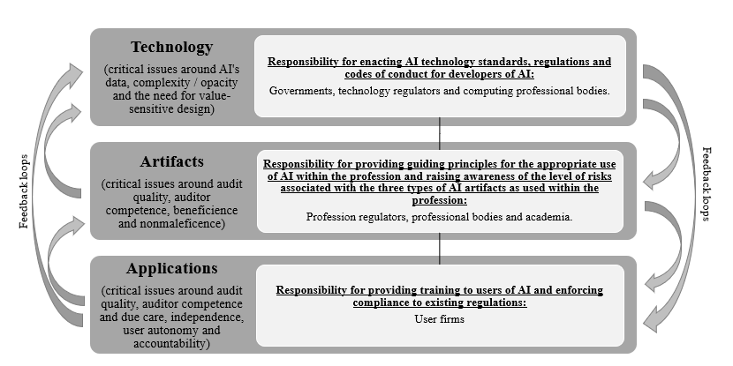
Proposed responsibility mapping
Munoko, I., Brown-Liburd, H.L. and Vasarhelyi, M., 2020. The Ethical Implications of Using Artificial Intelligence in Auditing.Forthcoming. Journal of Business Ethics.

